Slide 1
Marketing 101
How to create an effective advertising campaign

Slide 2
First: Determine your target Market
Many businesses say they target "anyone interested in my services." Some may say they target small business owners, homeowners, or stay-at-home moms. All of these targets are too general.
Targeting a specific market does not mean that you have to exclude people that do not fit your criteria from buying from you. Rather, target marketing allows you to focus your marketing dollars and brand message on a specific market that is more likely to buy from you than other markets.

Slide 3
An Example
For example, an interior design company could choose to market to homeowners between the ages of 35-65 with incomes of $150,000+ in the Baton Rouge, Louisiana, market. To define the market even further, the company could choose to target only those interested in kitchen and bath remodeling and traditional styles. This market could be broken down into two niches: parents on the go and retiring baby boomers

Slide 4
Look at your customer base
Who are your current customers, and why do they buy from you? Look for common characteristics and interests.
Which ones bring in the most business? It is very likely that other people like them could also benefit from your product/service.

Slide 5
Check out Your Competition
Who are your competitors targeting?
Who are their current customers?
Don't go after the same market. You may find a niche market that they are overlooking.

Slide 6
Analyze Your Product or service
Write out a list of each feature of your product or service. Next to each feature, list the benefits they provide (and the benefits of those benefits). For example, a graphic designer offers high quality design services. The resulting benefit is a professional company image. A professional image will attract more customers because they see the company as professional and trustworthy. So ultimately, the benefit of high quality design is to gain more customers and make more money.

Slide 7
Analyze product or service continued
Once you have your benefits listed, make a list of people who have a need that your benefit fulfills. For example, a graphic designer could choose to target businesses interested in increasing their client base. While this is still too general, you now have a base to start from

Slide 8
Choose Specific Demographics to Target
Figure out not only who has a need for your product or service, but also who is most likely to buy it. Think about the following factors:
• Age • Location • Gender • Income level • Education level • Marital or family status • Occupation • Ethnic background

Slide 9
Consider the Psychographics of your target market
Psychographics are more personal characteristics of a person, including:
• Personality • Attitudes • Values • Interests/hobbies • Lifestyles • Behavior

Slide 10
Evaluate your decision
Once you've decided on a target market, be sure to consider these questions:
• Are there enough people that fit my criteria? • Will my target really benefit from my product/service? Will they see a need for it? • Do I understand what drives my target to make decisions? • Can they afford my product/service? • Can I reach them with my message? Are they easily accessible?

Slide 11
Can you determine these target Margets?
http://www.youtube.com/watch?v=FhljTM6vuEU

Slide 14
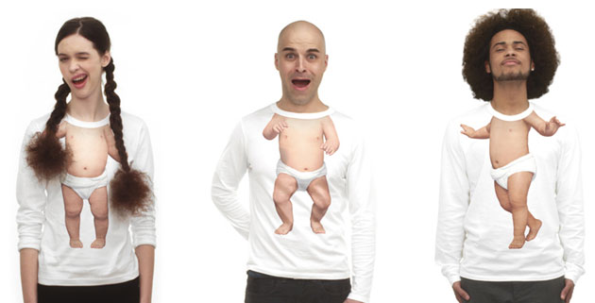
Evian Live Young

Slide 15
